Slide 1


Slide 2

About Us
Spotify’s platform revolutionized music listening forever when we launched in 2008
Today, more listeners than ever can discover, manage and enjoy over 100 million tracks, 6 million podcasts titles, and 350,000 audiobooks a la carte on Spotify
We are the world’s most popular audio streaming subscription service with more than 615 million users, including 239 million subscribers in more than 180 markets

Slide 3
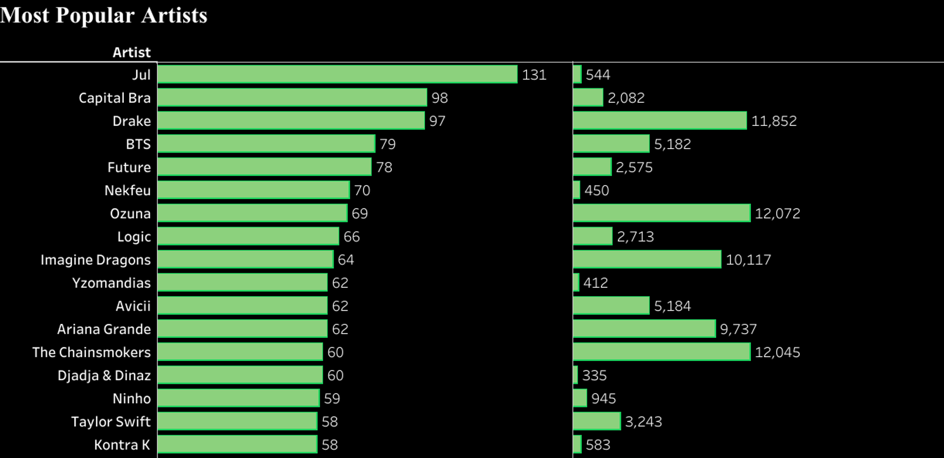
As you can see in this picture Most tracks owned by Jul (131), that doesn’t mean they have the most streams

Slide 4
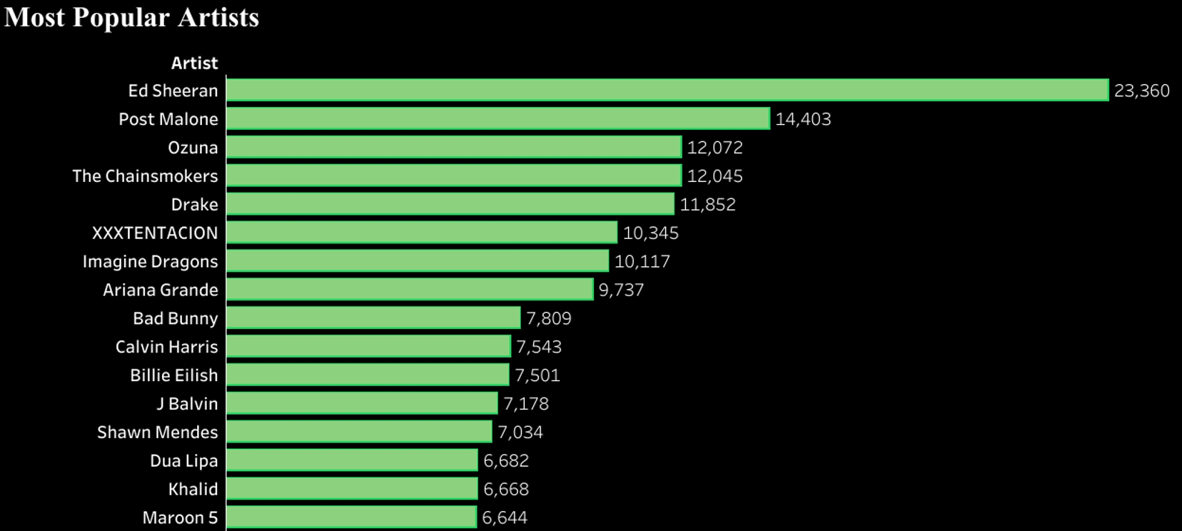
Most popular artist is Ed Sheeran with 23,360 stream as you can see below

Slide 5
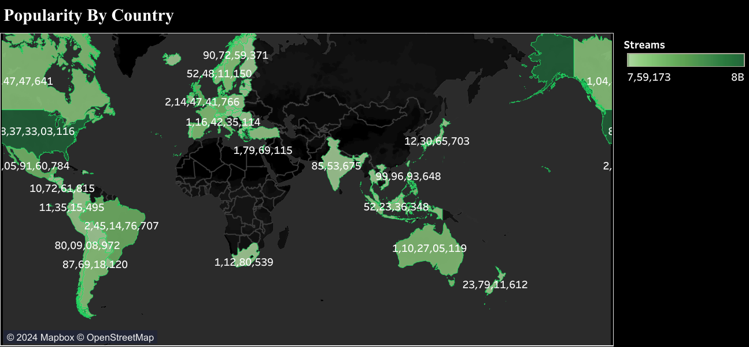
Through analysis we can find that united states has the most streams among other countries

Slide 6
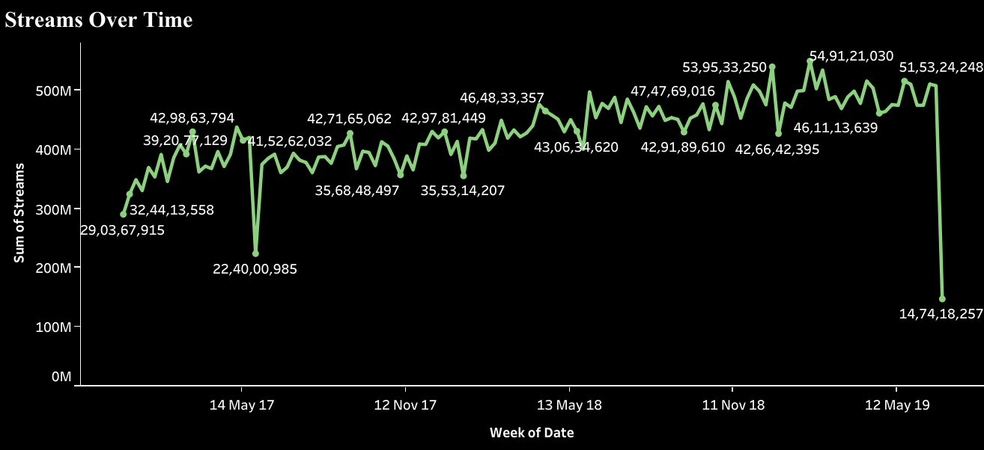
As we can see in the period of line chart, Feb 2019 has the highest streams in the three years

Slide 7
Facts about Spotify
With millions of songs available on the app, about 25% of the songs have not been played by users on Spotify
Spotify currently has 21,466,823 fans on Facebook. That's a 471% increase in 5 years since July 2013
Users need a stable and fast internet connection to stream the best quality music on Spotify. A premium user consumes 2.40 MB per minute, which is 115.2 MB every hour
Spotify has more than 83 million paid subscribers and occupies about 40% of the global music streaming market
20 billion hours of music In 2015, was streamed on Spotify

Slide 8
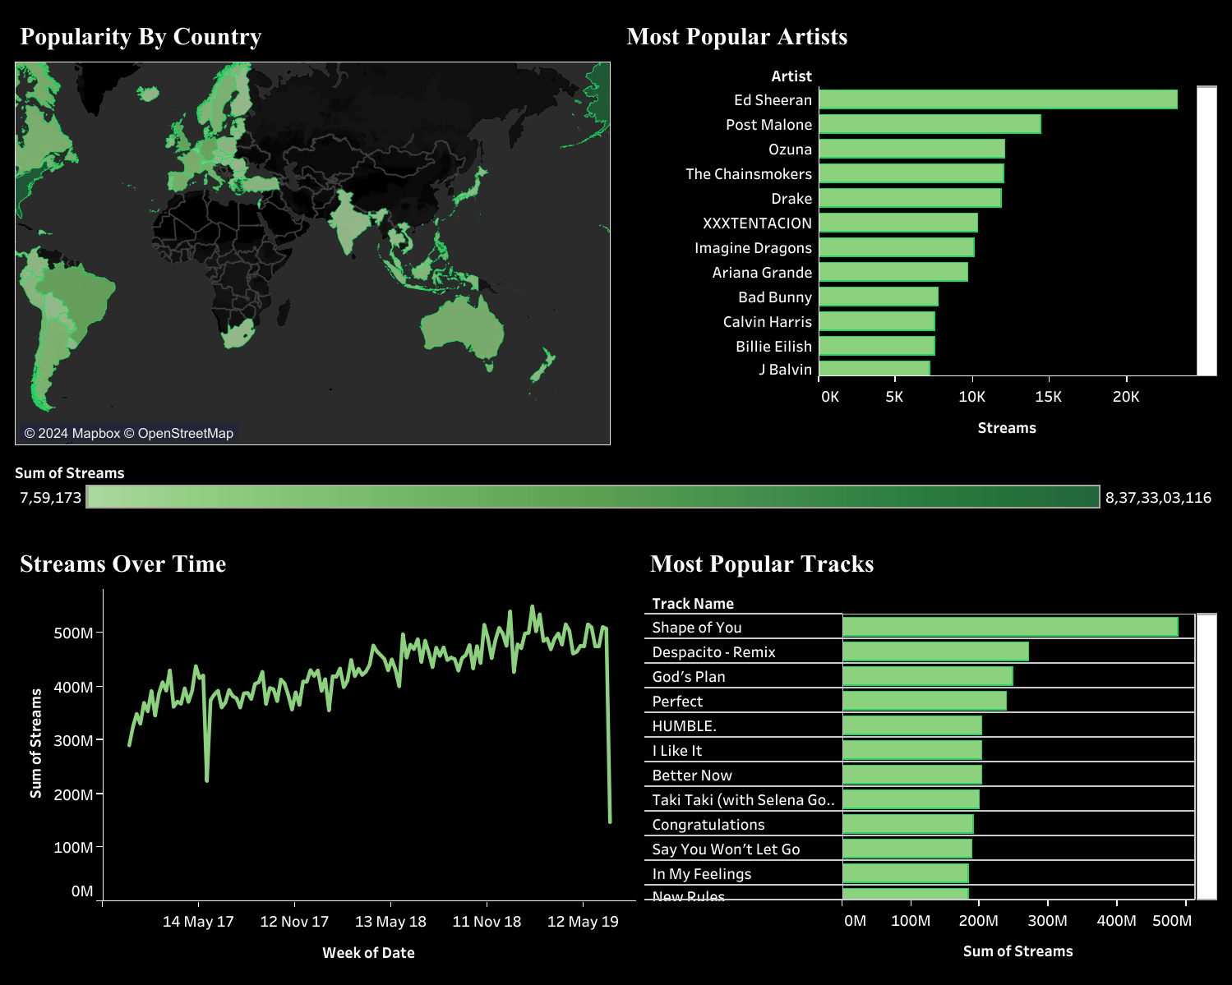
Analyze Spotify trends using tableau
https://public.tableau.com/views/AnalyzeSpotifytrendsusingtableau/AnalysisofspotifyDashboard?:language=en-US&:sid=&:display_count=n&:origin=viz_share_link

Slide 9
Reference
https://newsroom.spotify.com/company-info/
https://www.mirrorreview.com/green-shade-spotify-logo/

Slide 10

THANK YOU

